Slide 1
W
L
O
E
E
C
M
To Our Presentation

Slide 2
Project Name: An Analysis of Bangladesh’s Diplomatic Challenges and Opportunities with global and Regional Super Power : Perspectives from Students of Begum Rokeya University, Rangpur
Our Group Members are:
Mst. Tajmin Akter -12014014
Farhana Jui -12014024
Most. Ismoara -12014034
Roni Chandra Sharma -12014044
Sadia Arfin Hemu - 12014054
Md. Sojib Mia - 12014064
A.K.M Meheraj Hasnat Sark - 12014074
Minzanur Rahman - 1914064

Slide 3
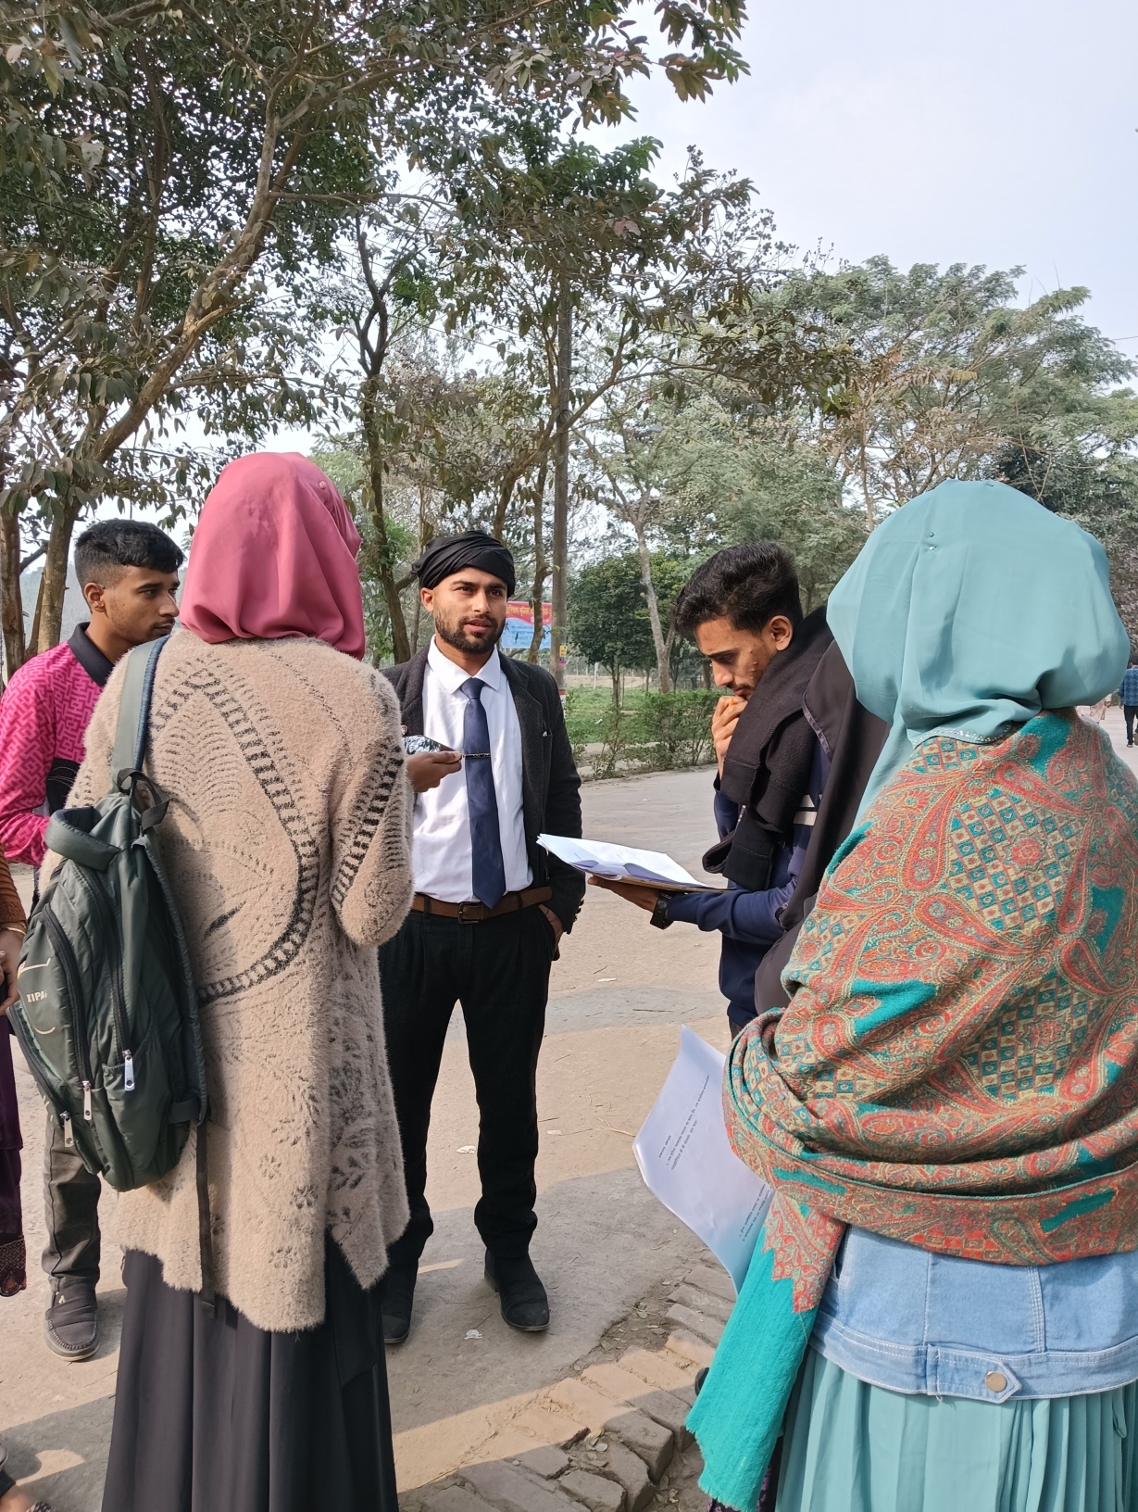
Sami ibne Ombor
Gender &Development
University of Dhaka.
He is the first respondent of our poject.

Slide 4
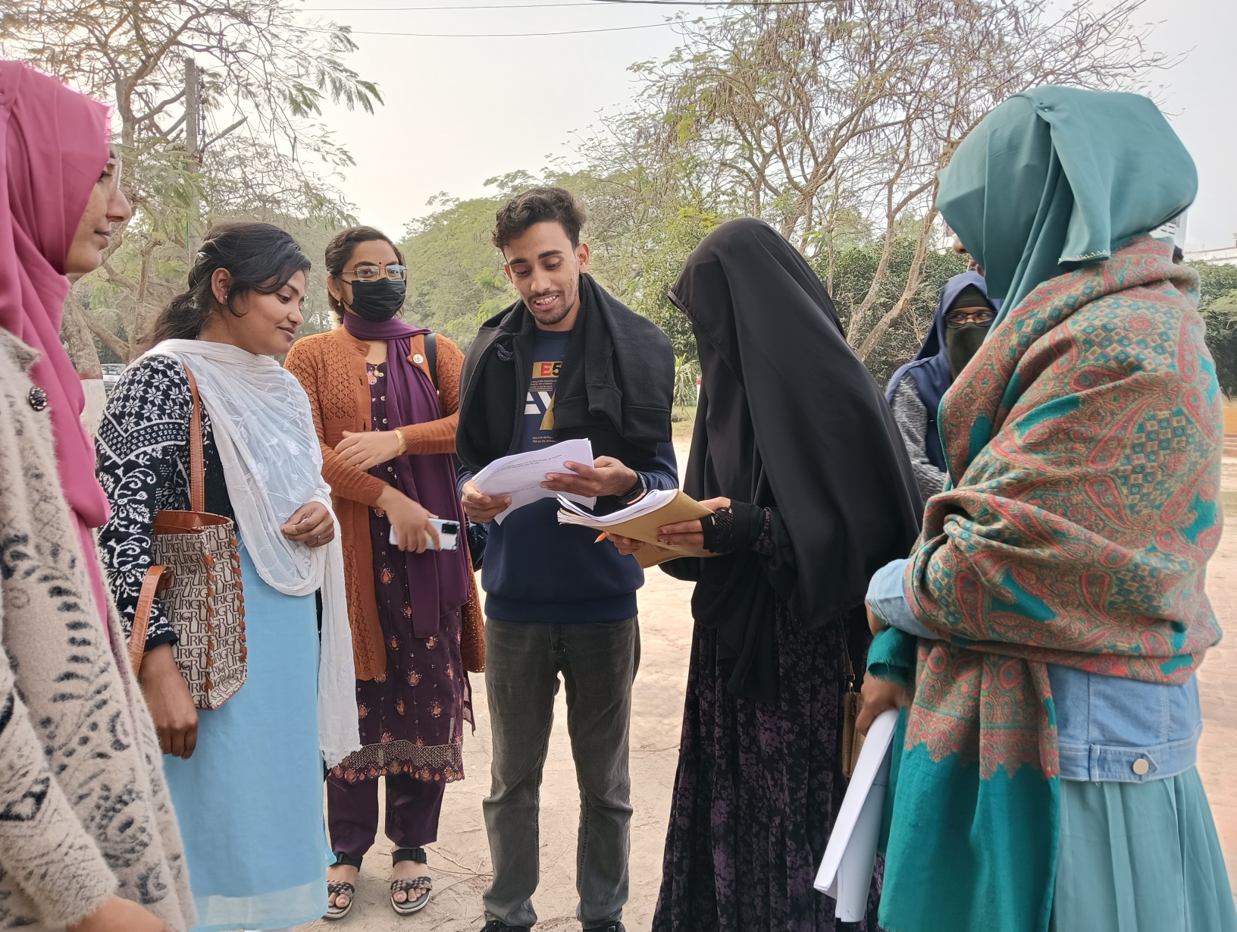
Juthy Rani
Public Admistation
Sesson:2019-20
BRUR
2nd respondent

Slide 5
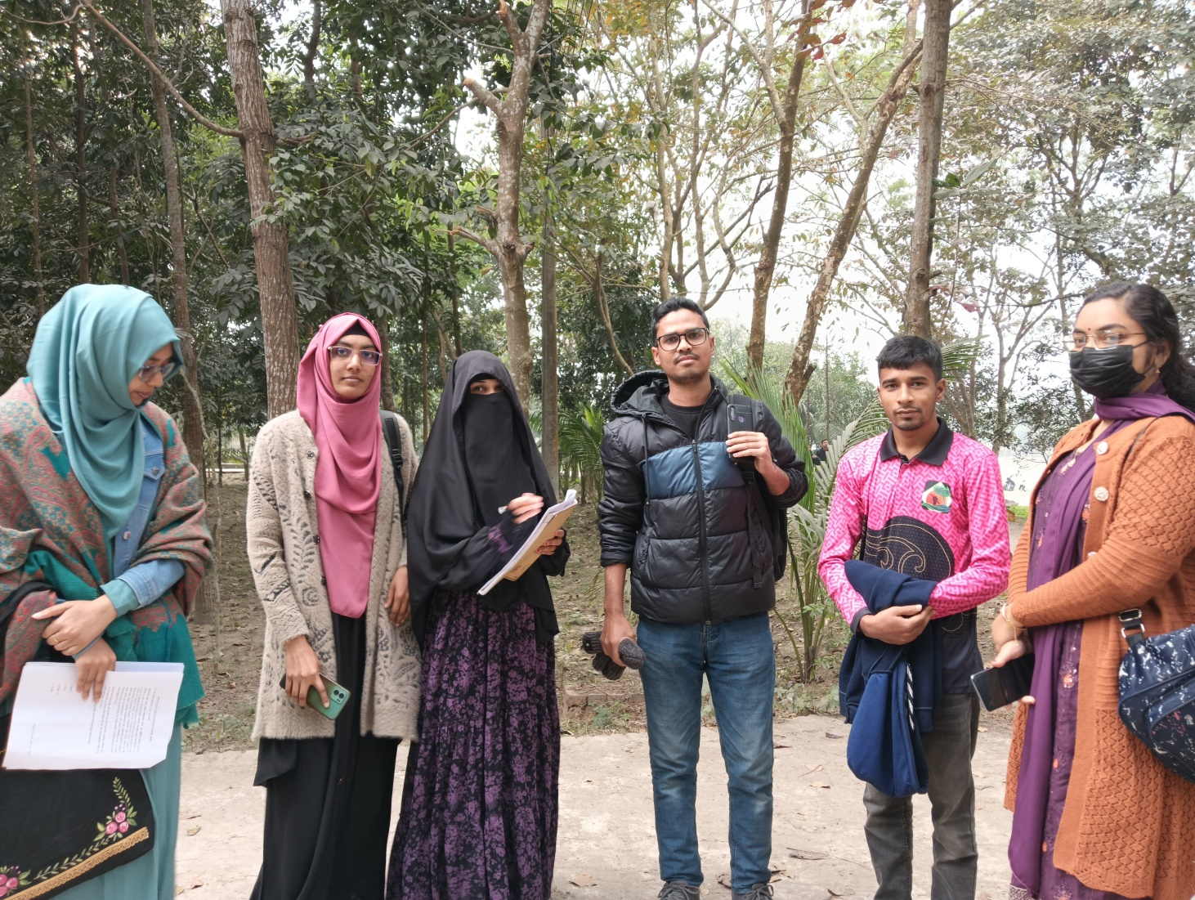
Habibur Rahman
Eng(2013-14)
BRUR
3rd respondent

Slide 6
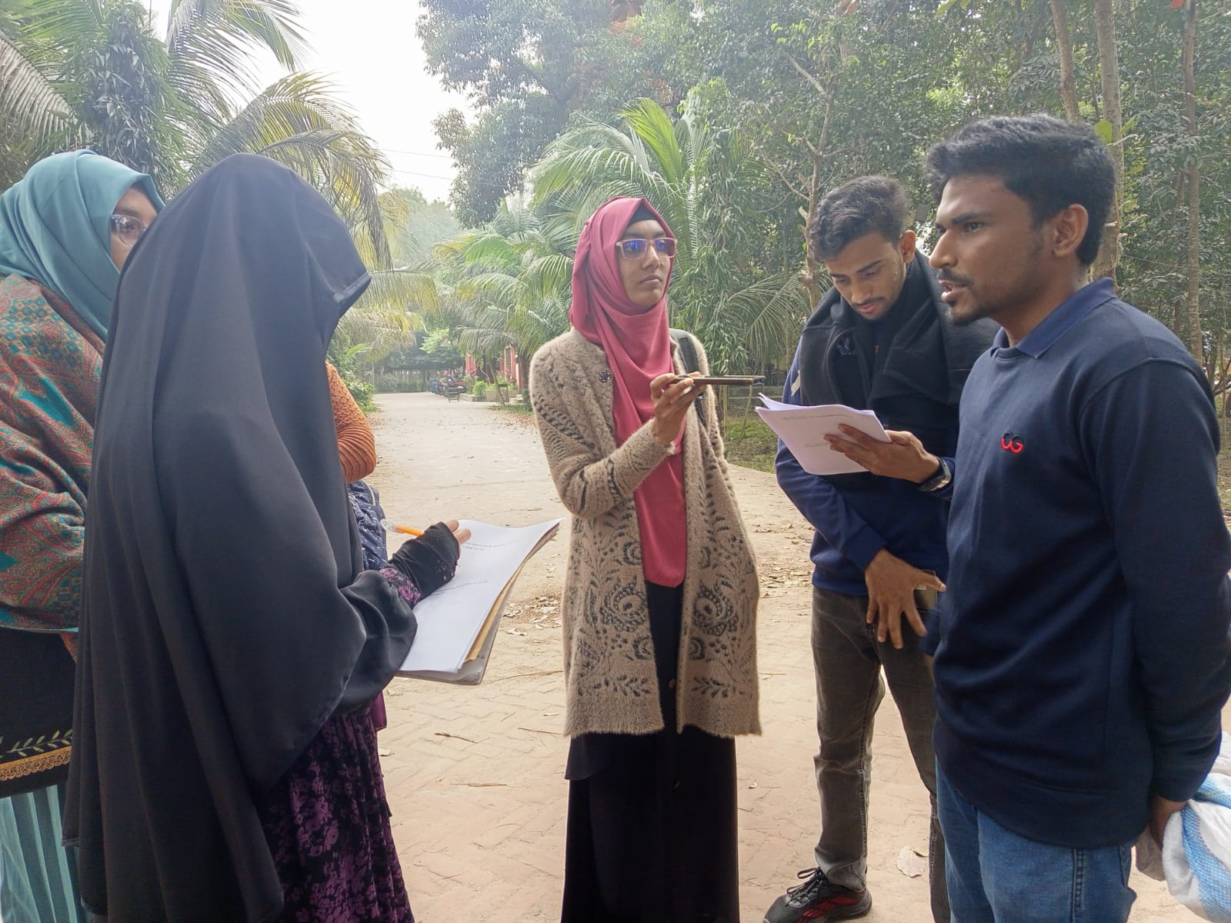
Sabbir Hossen
Economy (2019-20)
BRUR
4th respondent

Slide 7
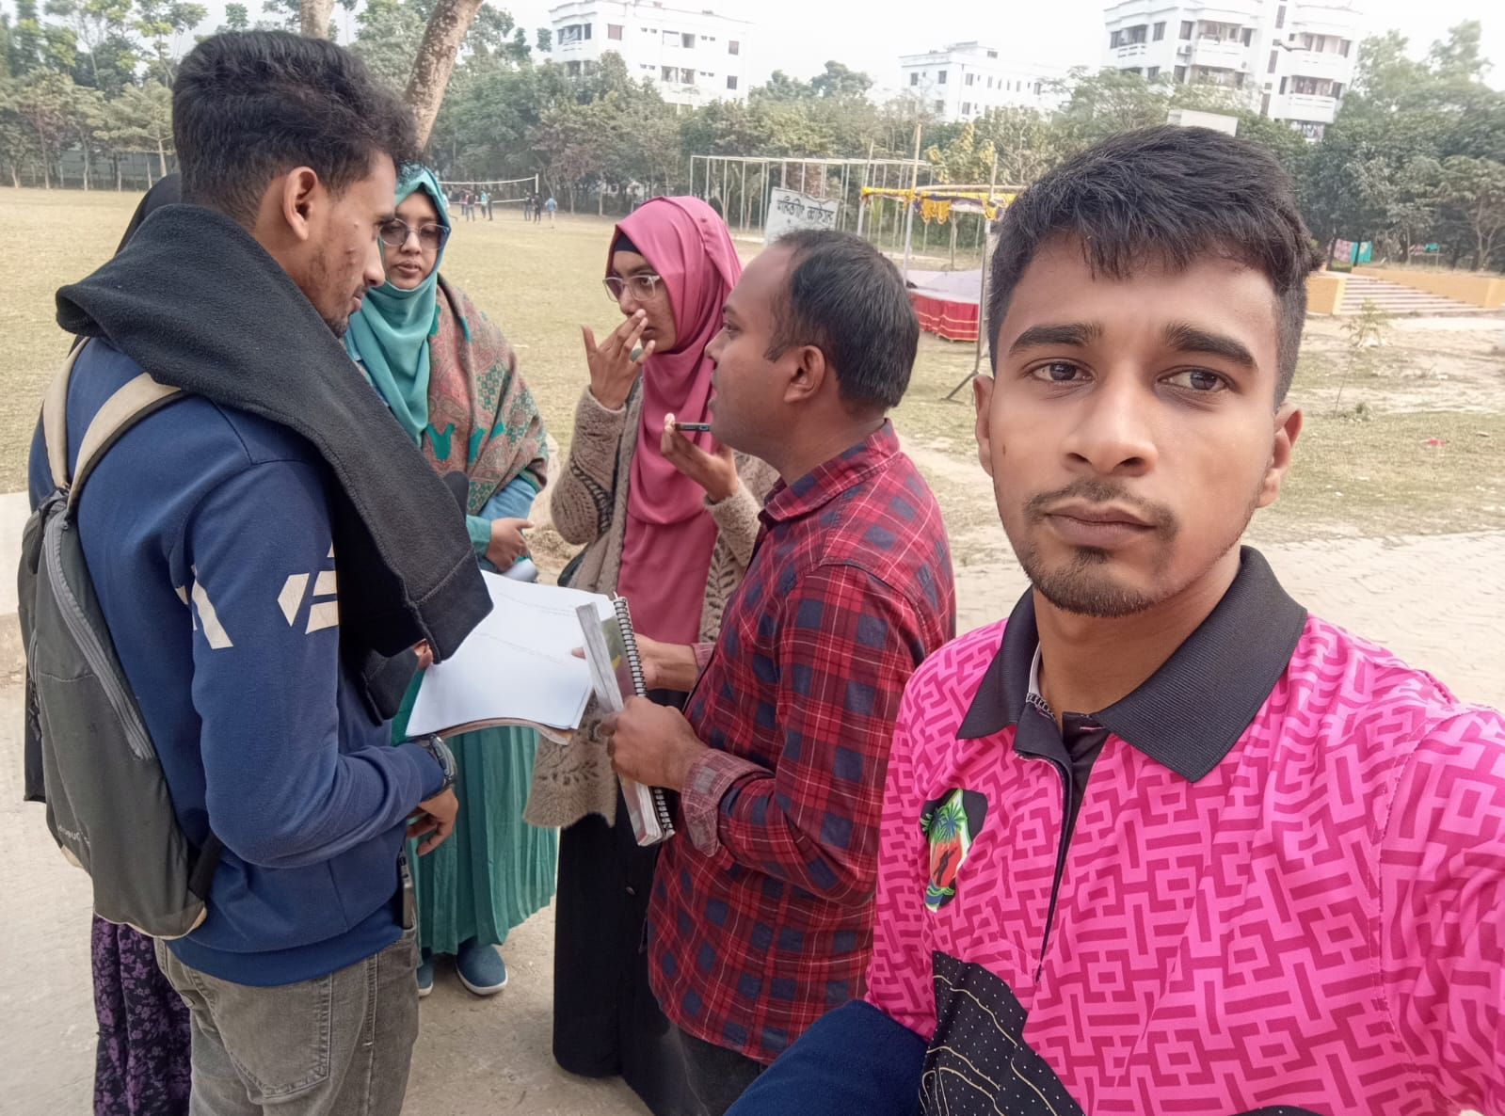
Joy Islam
Political Science (2016-17)
BRUR
5th respondent

Slide 8
1. What changes might occur in the foreign policies of India, China, and the United States regarding Bangladesh after the fall of the Sheikh Hasina government?
India:
The relationship between the Indian government and Sheikh Hasina's government is strong. If the current government adopts an anti-India stance, it could negatively impact India-Bangladesh relations, potentially leading to complications in agreements such as water and border treaties.
U.S. Foreign Policy:
In its effort to counter China's influence and expand its presence in the Indian Ocean, the U.S. may seek to maintain Bangladesh as a strategic ally.
China:
Through the Belt and Road Initiative, China may attempt to increase its investments in Bangladesh.
It could adopt strategies to reduce India's influence and focus on loans and infrastructure projects.

Slide 9
2. What kind of changes might be seen in U.S. foreign policy if Trump is re-elected, and how could those changes affect its relationship with Bangladesh?
The United States primarily emphasizes establishing democracy and human rights as its standard. Even if the Trump administration is re-elected, there will not be significant changes in U.S. foreign policy. This is because, regardless of the administration, the U.S. mainly focuses on increasing its power and military strength while attempting to control smaller nations.
The Trump administration may give lower priority to addressing various crises, such as the Rohingya crisis.
There could be stricter trade and economic relations to reduce dependence on China.

Slide 10
3. Bangladesh has a large number of infrastructure agreements with China. Are these increasing our dependence on China?
This can be explained in two ways.
Firstly, due to many infrastructure agreements and the significant loans taken, Bangladesh is becoming obligated to China. Since China is heavily involved in infrastructure projects, our dependence on them is increasing.
Secondly, as China is investing in Bangladesh, they are also taking a share of the profits accordingly. The Bangladesh government is also repaying the loans. In this case, China is investing in Bangladesh for its own interests. Therefore, it can be said that infrastructure agreements are not solely increasing our dependence on China. These are merely bilateral agreements for mutual benefit. China is not helping Bangladesh without serving its own interests.

Slide 11
4. What might Bangladesh's diplomatic relations with the European Union look like in the future, particularly in the ready-made garment sector, after existing from LDC status?
After existing from LDC status, new opportunities for commercial agreements will emerge.
Upon exiting LDC status, Bangladesh's garment industry will need to become more competitive in the EU market.
The European Union may exert pressure on Bangladesh to improve safety standards and adopt framework laws to maintain international standards.
After LDC existing , tariff rates in the EU market might increase.
Exiting LDC status could lead to enhanced diplomatic discussions and cooperation between Bangladesh and the EU.

Slide 12
5. Is Bangladesh's friendly relationship with Russia causing any issues in maintaining diplomatic balance with Western countries?
Bangladesh has had good relations with Russia for a long time, but since Western countries do not share a strong relationship with Russia, maintaining diplomatic balance with Western nations becomes somewhat challenging for Bangladesh. For instance, Western countries tend to import less and invest less in Bangladesh. They even attempt to exert political and economic pressure on Bangladesh.

Slide 13
6. How do you think Bangladesh will be able to maintain a
balance between China and America in its foreign
policy?
• -China is economically powerful, while America is strong in nuclear and
military aspects. In this case, Bangladesh should maintain a balance
by adopting a neutral foreign policy.
• Bangladesh&#39;s foreign policy should prioritize national interests above
all. It should not favor just one country, China or America, but treat both equally.
• Bangladesh should maintain balance by participating in coordinated diplomatic discussions without becoming directly involved in the competition between China and America.
• Multilateral diplomatic relations need to be developed. The focus
should be on reducing reliance on investments and import-export
relations solely with America and China.

Slide 14
7. What should Bangladesh&#39;s foreign policy be in the context of tensions between Russia and the West as a result of the Ukraine war?
Due to the increased tensions between Russia and the Western world resulting
from the Ukraine war, Bangladesh&#39;s foreign policy should be balanced and
interests-centric. The main directives may include:
• Neutral Position: Bangladesh should avoid direct involvement with any
party and play a neutral role in the conflict.
• Protection of National Interests: Any decisions made in the
international arena should be based on protecting Bangladesh&#39;s
economic and diplomatic interests.

Slide 15
• Multilateral Diplomacy: It is crucial to adopt a balanced diplomatic
strategy to maintain relations with Russia and the Western world. In
this context, calling for peace and dialogue in international forums,
including the United Nations, may be effective.
• Energy and Trade: Relations with Russia in the energy sector and with
the Western world in export and development cooperation should be
sustained.
• Humanitarian Perspective: Consideration of the humanitarian aspects
of the war requires support for peaceful resolutions, ensuring that
Bangladesh&#39;s policies are viewed positively on the global stage.
• Humanitarian Perspective: Support for a peaceful solution to the
conflict must be expressed by considering the humanitarian aspects of
the conflict, so that Bangladesh&#39;s policies are viewed positively in the global arena.
By following these principles, Bangladesh will be able to maintain
balance in the face of global tensions while preserving its own
interests.

Slide 16
8. What do you think Bangladesh&#39;s foreign policy should be in thecontext of strategic competition between India and China?
• Maintaining a balanced position without bias between India and China.
• Increasing economic, trade, and strategic relations with both countries.
• Reducing dependence by decreasing Chinese loans and seeking diversified sources, minimizing all forms of dependence on both India and China.
• Strengthening regional cooperation (for example, BIMSTEC, SAARC).

Slide 17
Thank you all
Specially sir Thank you.

